Slide 1
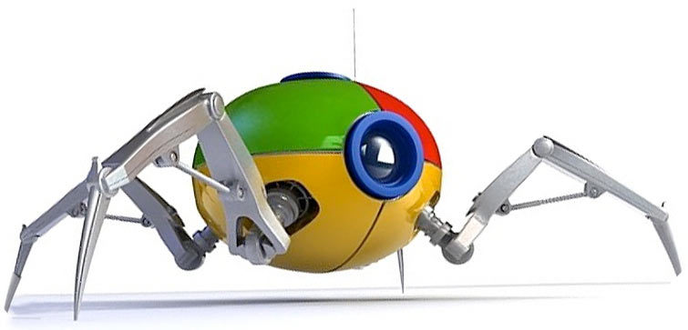

MINI PROJECT-1
WEB CRAWLING IN
SEARCH ENGINE OPTIMIZATION
Guide-
Mr. Amit Panwar
Presented By-
Himanshu Beniwal
B.Tech 4th Sem ‘CSE’
Roll no.- 17

Slide 2
Contents:
Instruction (Web Crawler and SEO).
Language used.
Factors affecting SEO
Controlling these ROBOTS.
Architecture of Crawler.
Architecture of Search Engine.
Crawler eye’s VS User eye’s.
Advantages VS Disadvantages of SEO
Conclusion

Slide 3
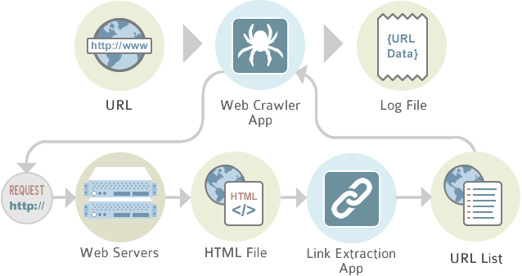
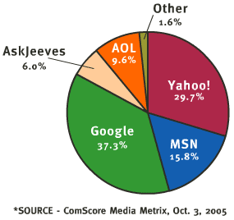
Introduction (Web crawlers) :
Crawling is the process by virtue of which the search engines gather information about websites on world wide web (new / old / updates etc.).
The crawlers are also known as Spiders or Bots , they visit website and send information to their respective parent websites.

Slide 4
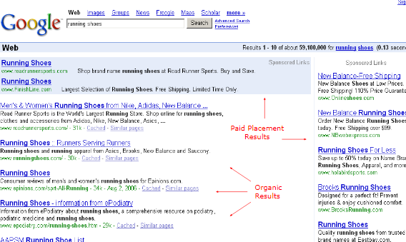
Introduction
Why Web crawlers?
Internet has a wide expanse of Information. Finding relevant information requires an
efficient mechanism.
Web Crawlers provide that scope to the search engine

Slide 5
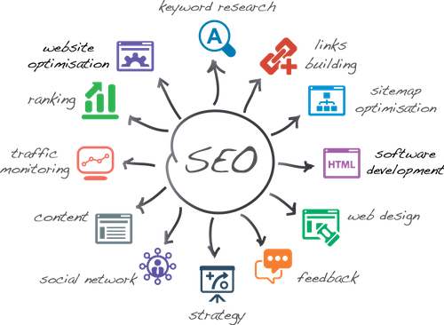

Introduction
Search Engine Optimization –SEO is Art and Science of Optimizing your web pages to be found by search engines like GOOGLE, YAHOO, BING etc.
SEO is the act of modifying a website to increase its ranking in the listings of SE’s (Search Engines).

Slide 6
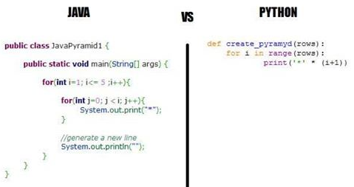

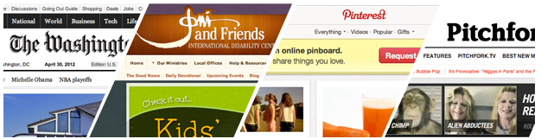
Why python?
Interpreted and Interactive language.
Build more function with fewer line of code.
Python is Flexible.
DJANGO, A HIGH-LEVEL PYTHON WEB FRAMEWORK.
Django Support best practices for SEO.

Slide 7
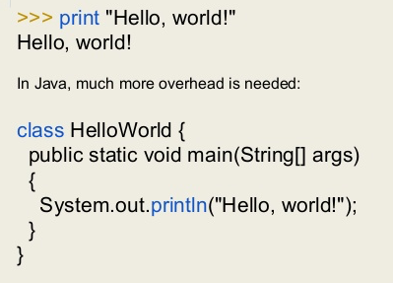
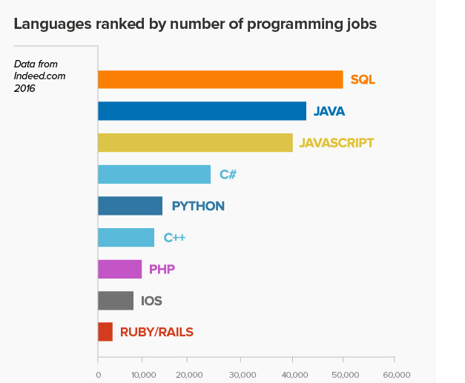
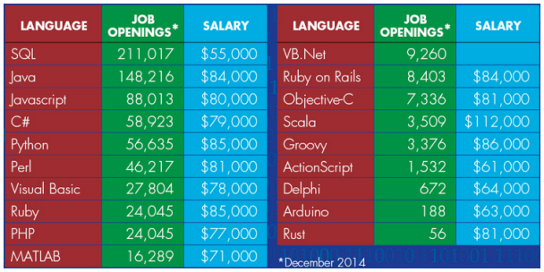
Why python?

Slide 8

FACTORS AFFECTING seo!
ON-Page Optimization:
Title, Meta tags.
Meta Description tag.
Heading Tags ( h1>h2>h3…), Length of Content.
Image Optimization (using ‘ALT’ tag).
Internal Links.
Keywords must be in URL.
No Duplicate Content.

Slide 9
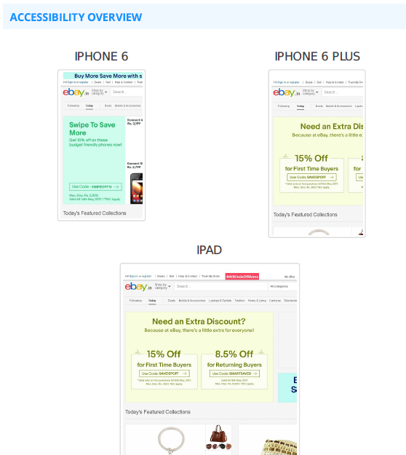
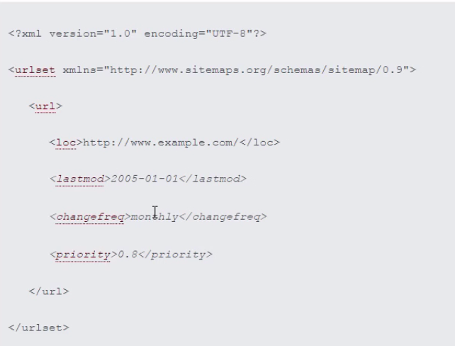
FACTORS AFFECTING seo!
2. SITE Factors:
Sitemaps (-link-.com/sitemaps.xml)
Domain Trust.
Server Location.
Mobile Optimized Site.
Google Web-Master Tools.

Slide 10
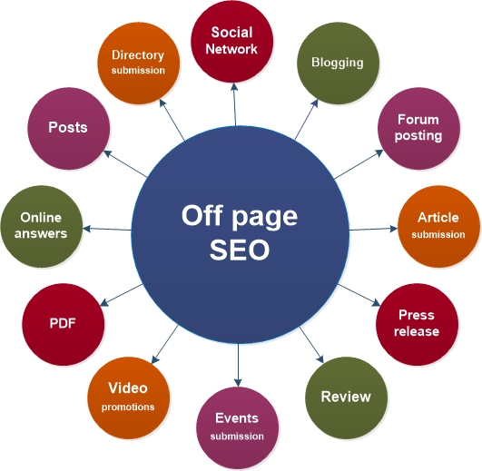
FACTORS AFFECTING seo!
3. Off-Page Optimization:
Back linking of Pages, and Domains.
Link Relevancy.
Domain Authority of Linking Page.
Links from a Homepage.
Dofollow VS Nofollow Links.
Contextual Links.
Link Anchor.
Black Hats Techniques will give a degrade in your Current Ranking.

Slide 11
FACTORS AFFECTING seo!
4. Domain Factors:
Domain Registration Length (abc-xyz-pqr-ijk.com)
Domain History
Country TLD extension. (.pl, .co.uk , .ie)
Site administrator puts a “robots.txt” file at the root of the host’s web directory.
“http://www.ebay.com/robots.txt”

Slide 12
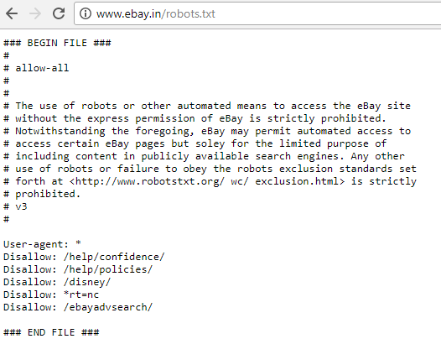
Controlling robots!
Web sites and pages can specify that robots should not crawl/index certain areas.
Two components:
Robots Exclusion Protocol (robots.txt): Site wide specification of excluded directories.
Robots META Tag: Individual document tag to exclude indexing or following links.
Site administrator puts a “robots.txt” file at the root of the host’s web directory.
http://www.ebay.com/robots.txt
Exclude a specific robot:
User-agent: GoogleBot Disallow: /
Allow a specific robot:
User-agent: * Disallow:

Slide 13
Architecture of Crawler:
URL Pushed to Queue
CRAWLER
URL QUEUE’s
Extract
CRAWLER
Creating
Database
Push Initial Set
CRAWLER
Fetch URL’s
Database
Seed URL’s
Internet

Slide 14
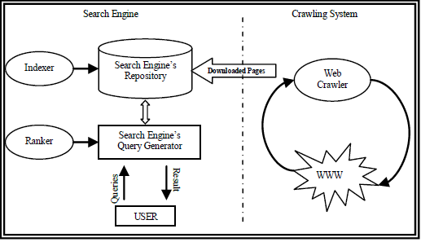
Architecture of Search Engine -

Slide 15
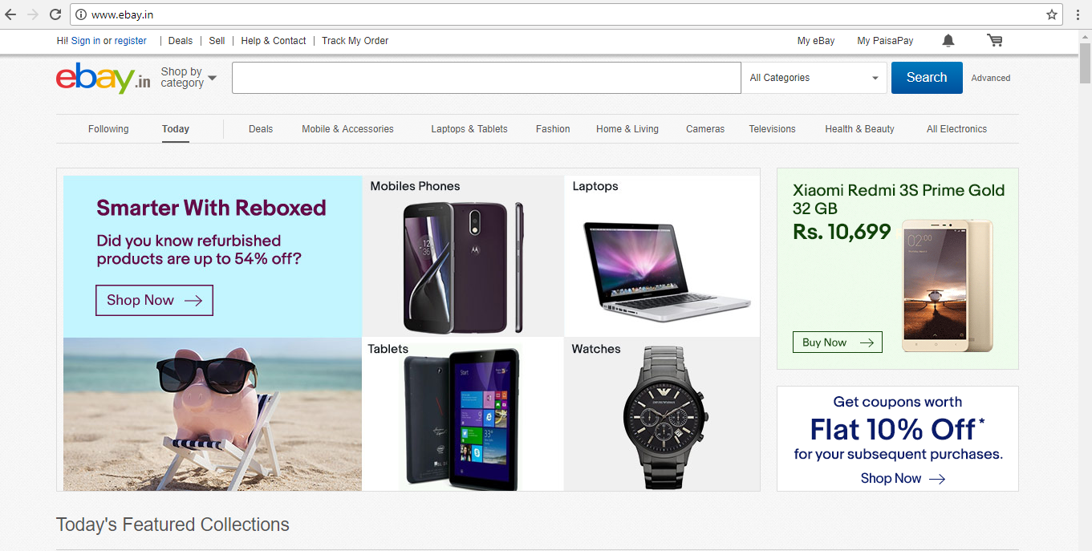
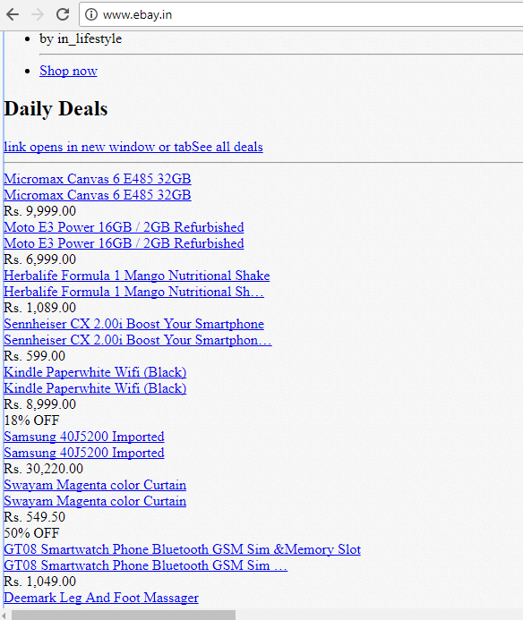
Crawler eye’s vs user eye’s!

Slide 16

Advantages of seo
High demand for SEO service.
Search Engine Optimization make Good Money.
Lots of Learning.
Great Analytic skills.
Creative Marketing strategies.
Can really enhance Career.
Great salary (Rs 1.8-4 Lacs per year for Fresher's).
Various Job Categories.

Slide 17
disadvantage's of seo
Dependent on Search Engine’s.
No Fixed rules.
Rapid Changes in ranking.
SEO requires Patience.
Black Hat SEO.

Slide 18
Conclusion
A crawler is a program that retrieves and stores pages from the Web, commonly for a Web search engine.
SEO plays a fundamental role in scaling up sales and speed up the growth of a completely online business (such as Flipkart.com or Snapdeal.com) or an offline business (such as KFC).

Slide 19
References
WIKIPEDIA(https://en.wikipedia.org/wiki/Search_engine_optimization#As_a_marketing_strategy)
Why Make Career In Search Engine Optimization (SEO)-(https://www.linkedin.com/pulse/why-make-career-search-engine-optimization-seo-scope-gulshan-sirohi)
Web Crawler-(https://en.wikipedia.org/wiki/Web_crawler)
How Stuff Works-(http://computer.howstuffworks.com/internet/basics/search-engine1.htm).

Slide 20
Thank you..

